Slide 1

Live Session Unit 13
Javier Saldana

Slide 2
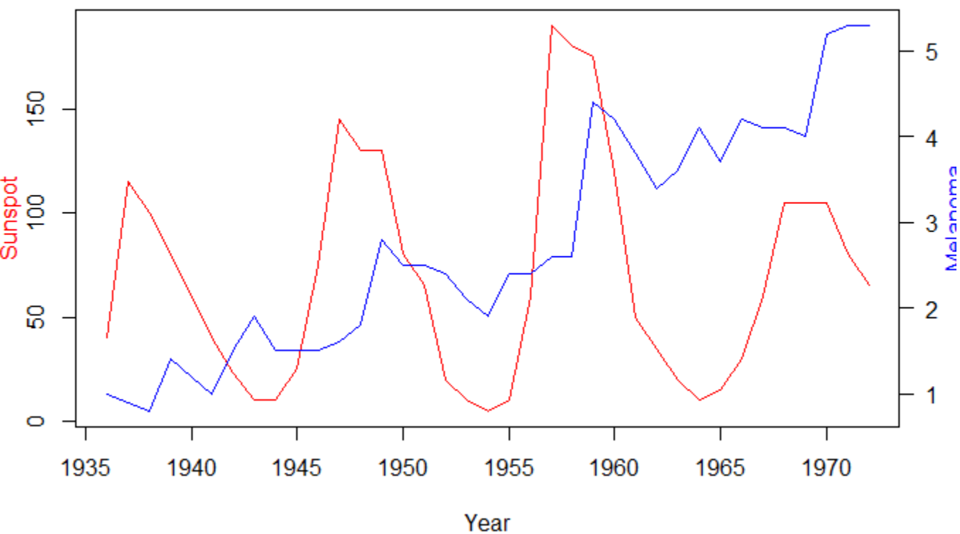
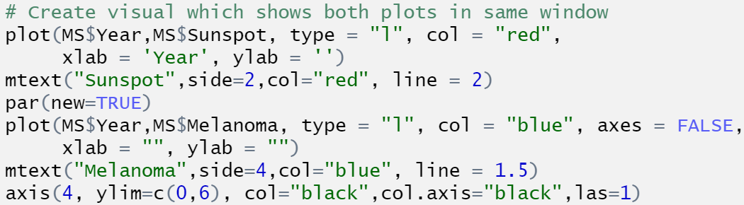
Sunspot/Melanoma - MLP
Just based on a purely visual inspection, it is clear there is a slight peak associated between the sunspots and melanoma. In fact, it even looks like the sunspots are occurring first and then melanoma lags behind slightly.

Slide 3
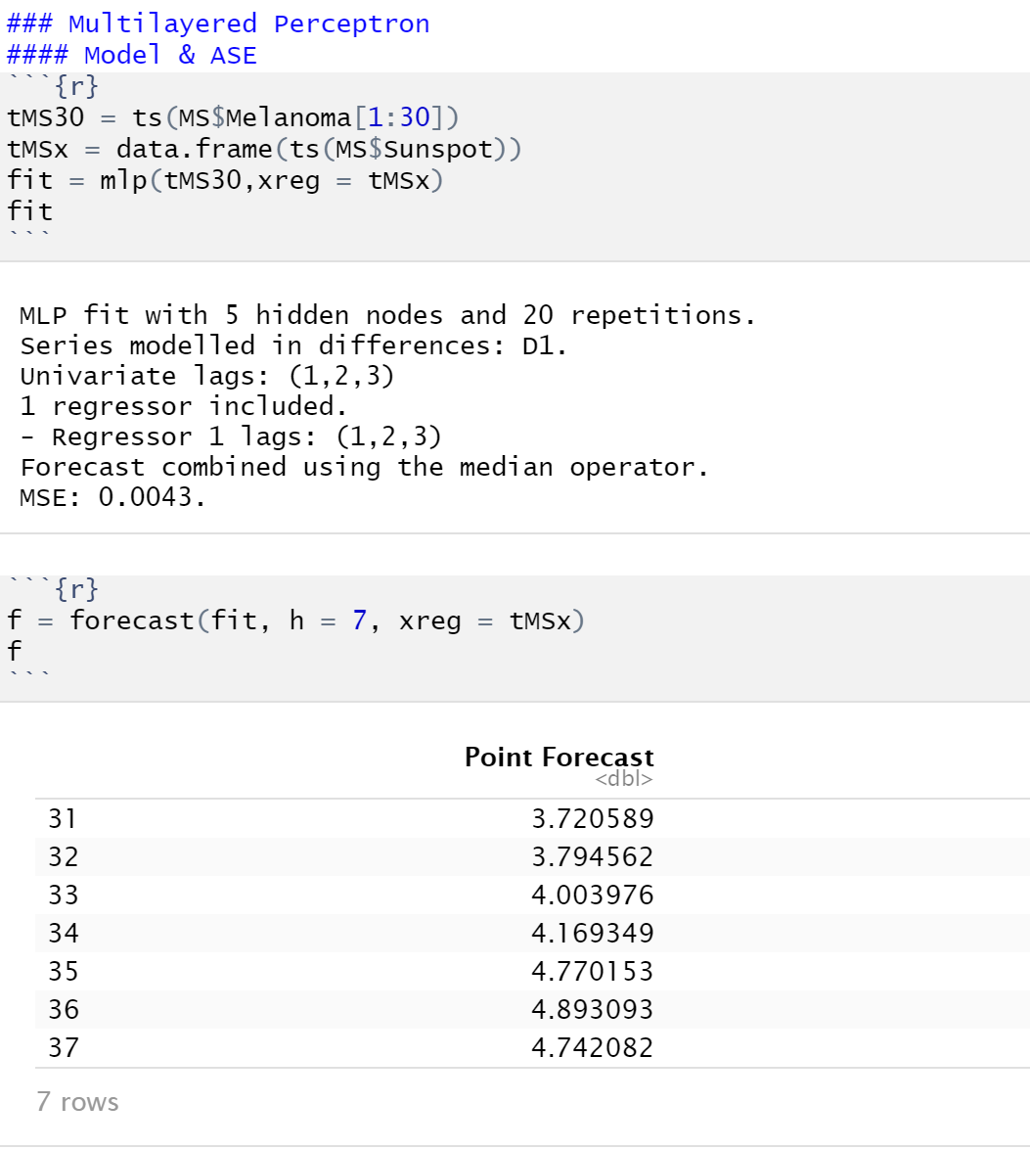
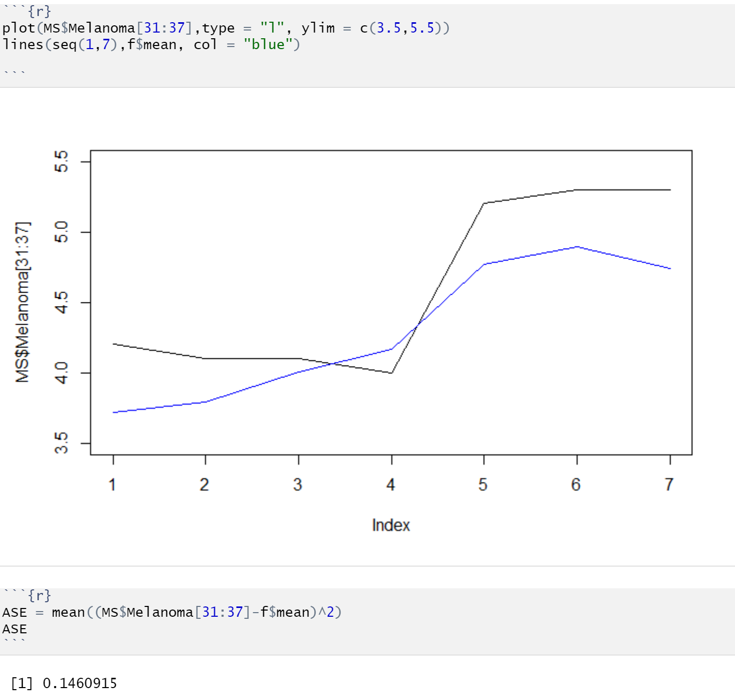
Sunspot/Melanoma - MLP

Slide 4
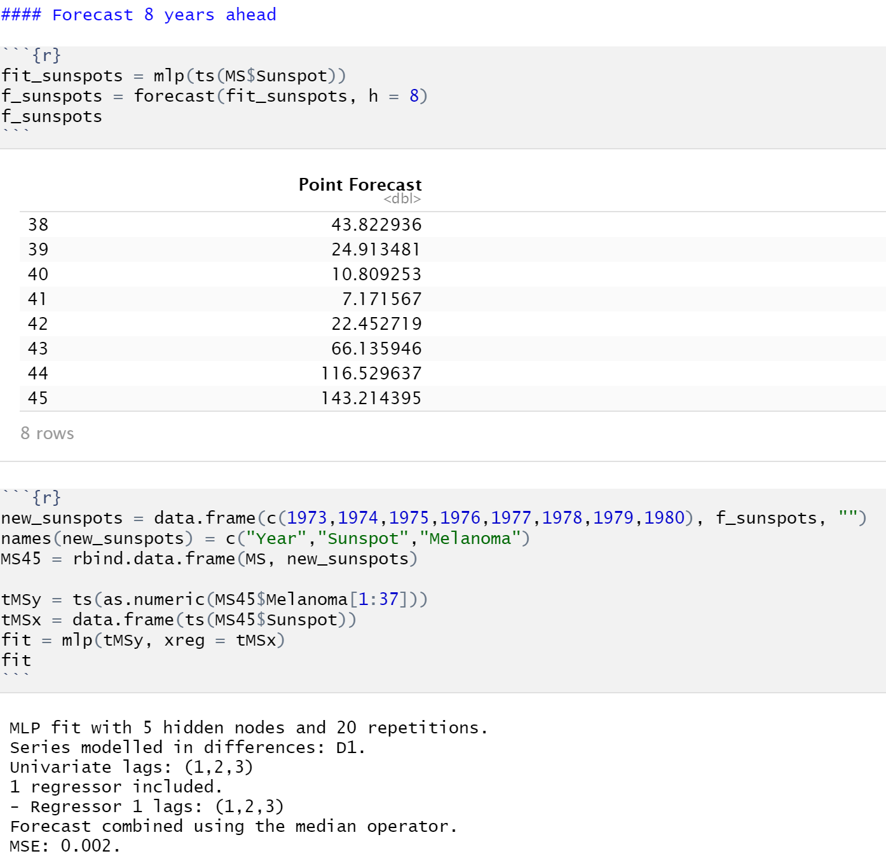
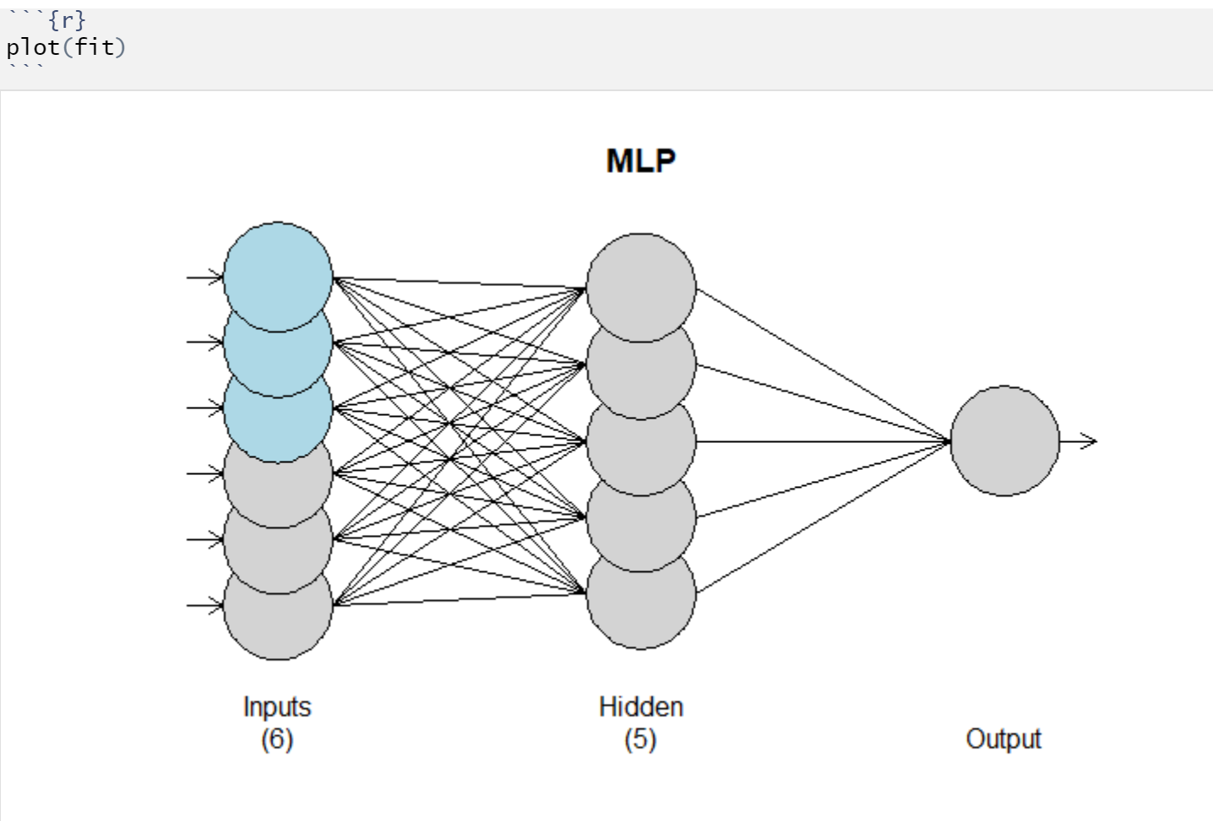
Sunspot/Melanoma - MLP

Slide 5
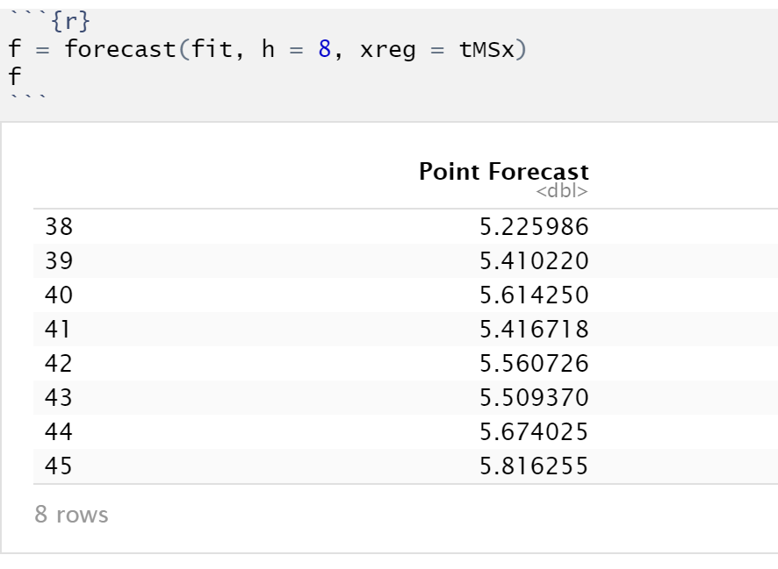
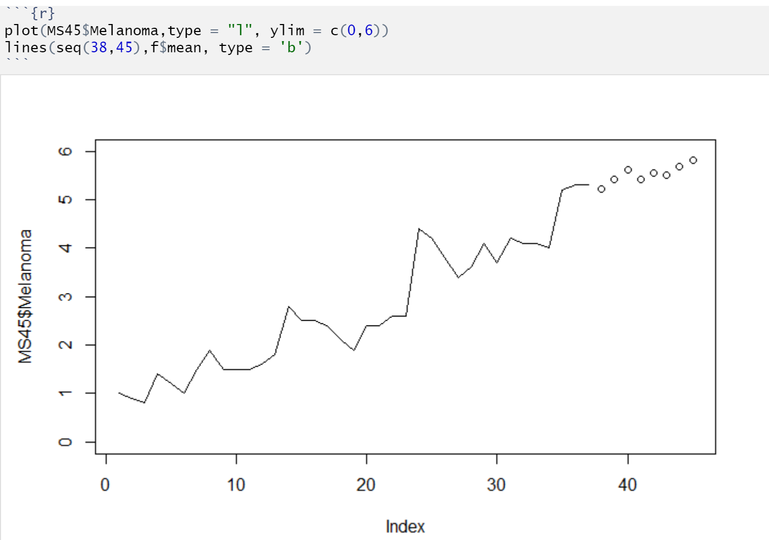
Sunspot/Melanoma - MLP

Slide 6
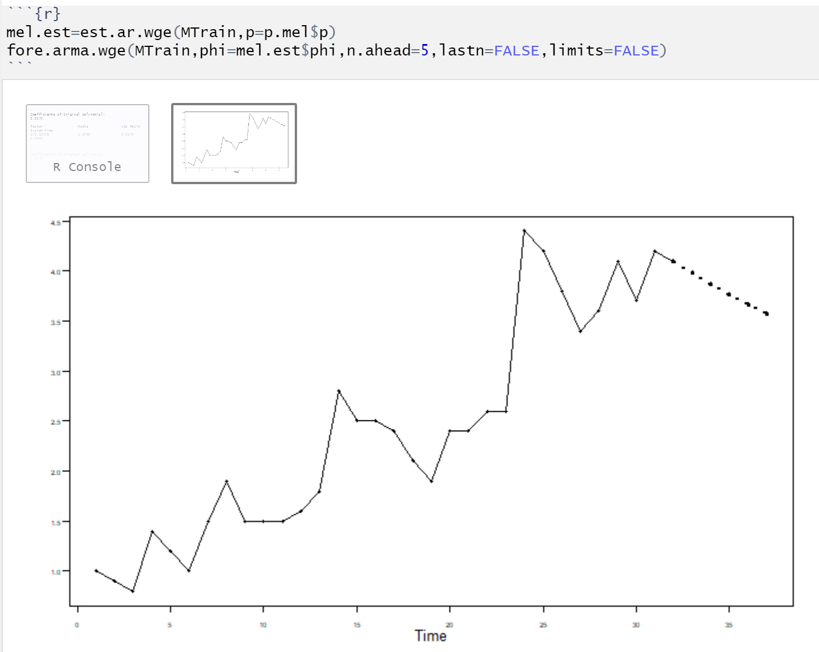
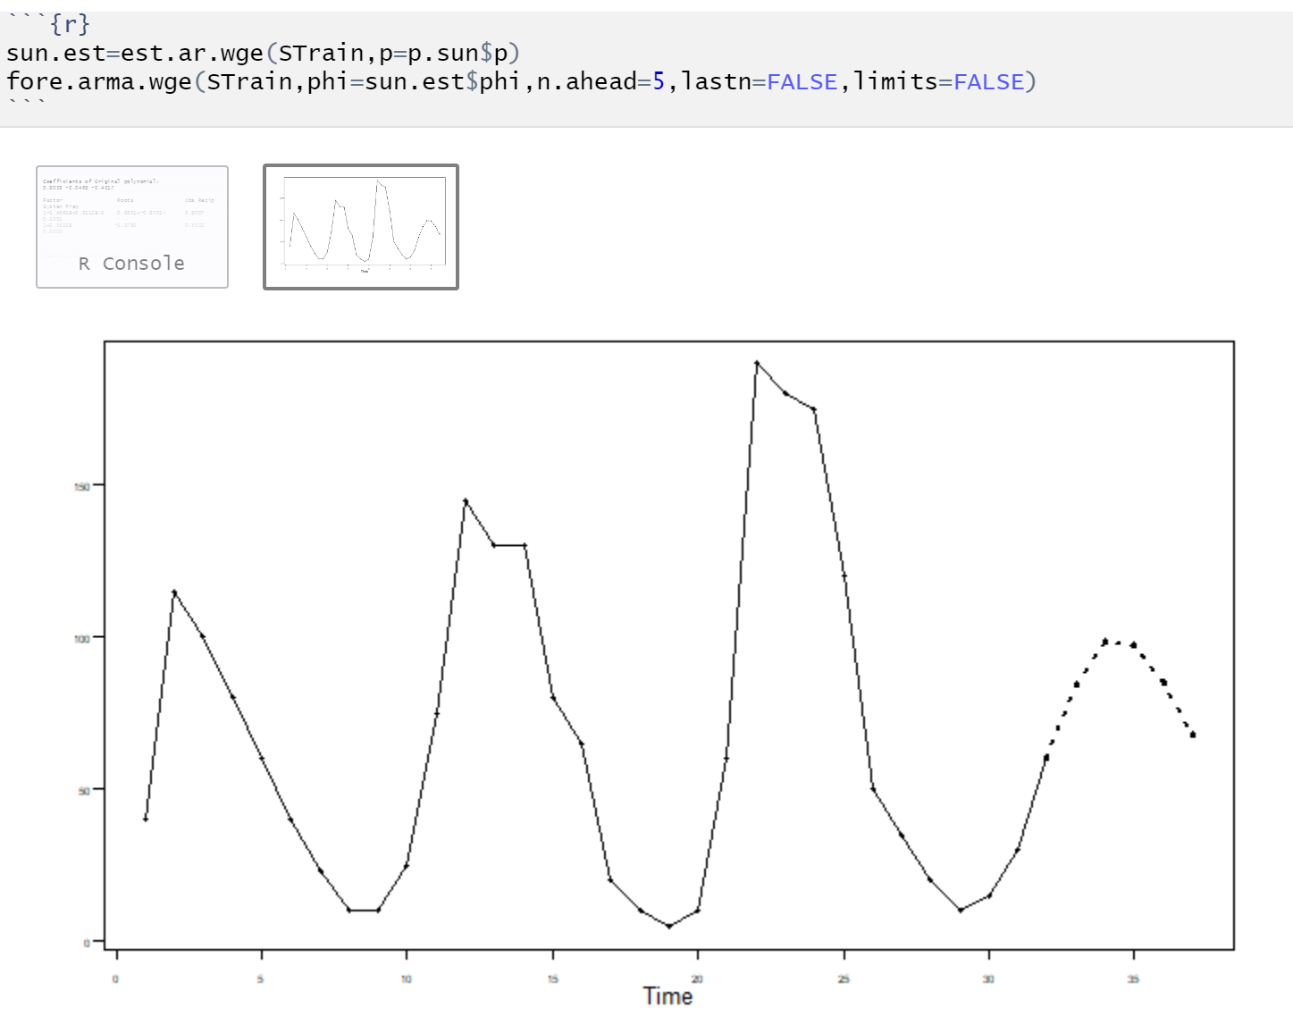
Sunspot/Melanoma - VAR

Slide 7
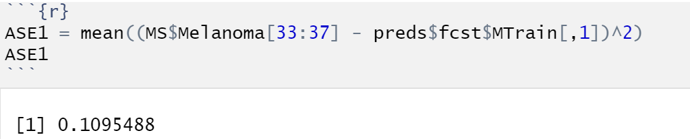
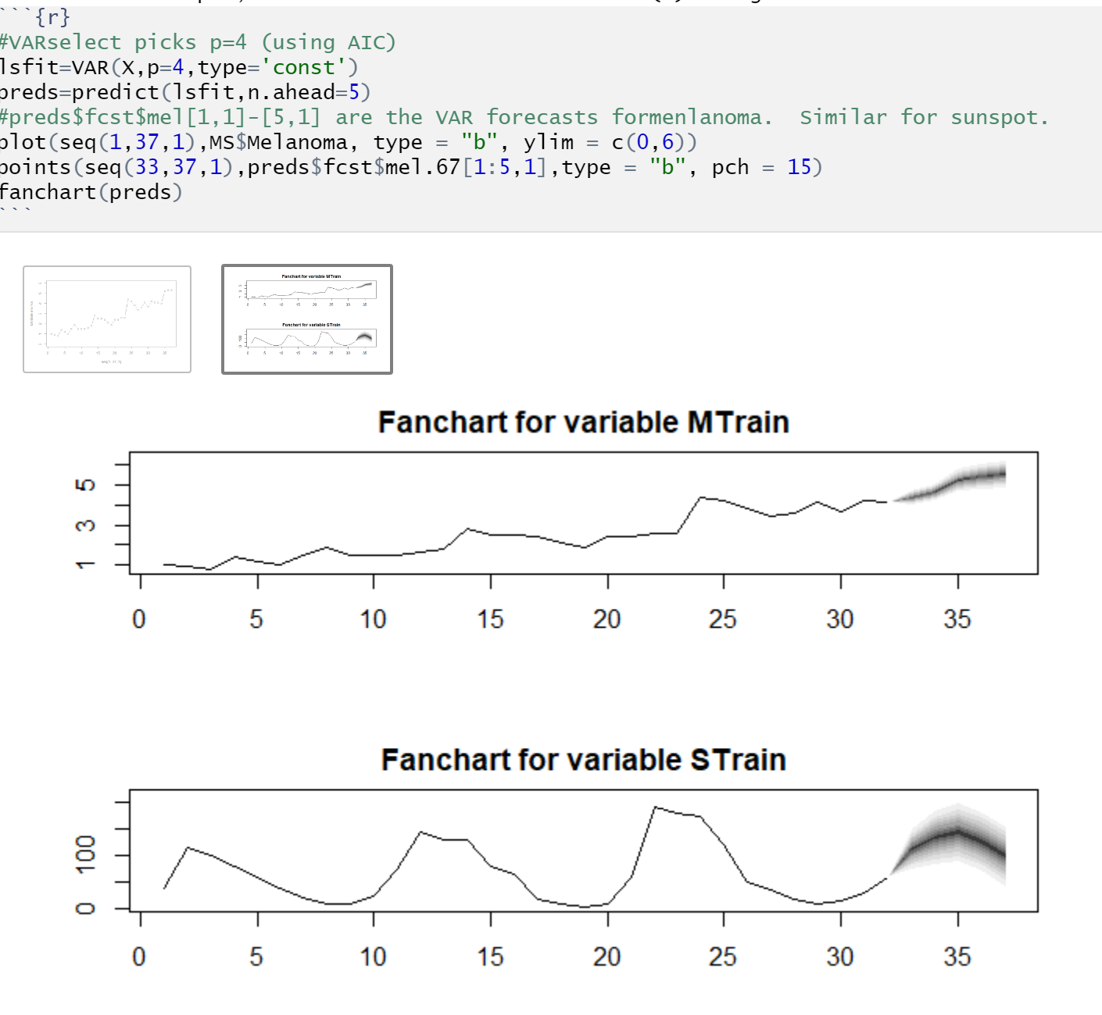
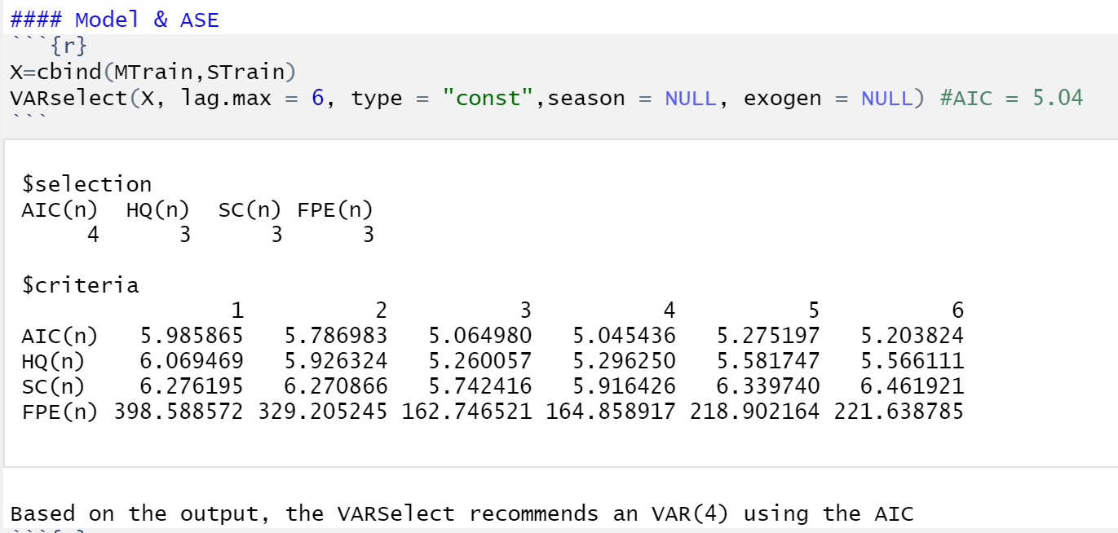
Sunspot/Melanoma - VAR

Slide 8
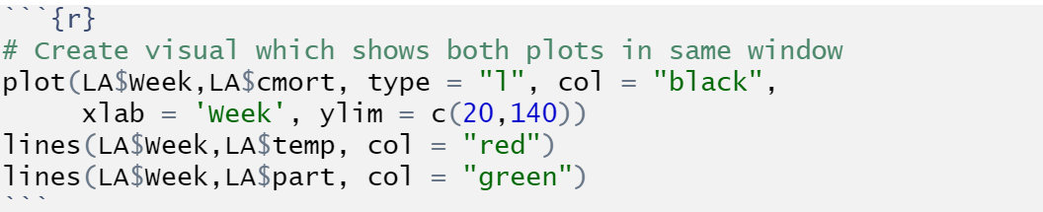
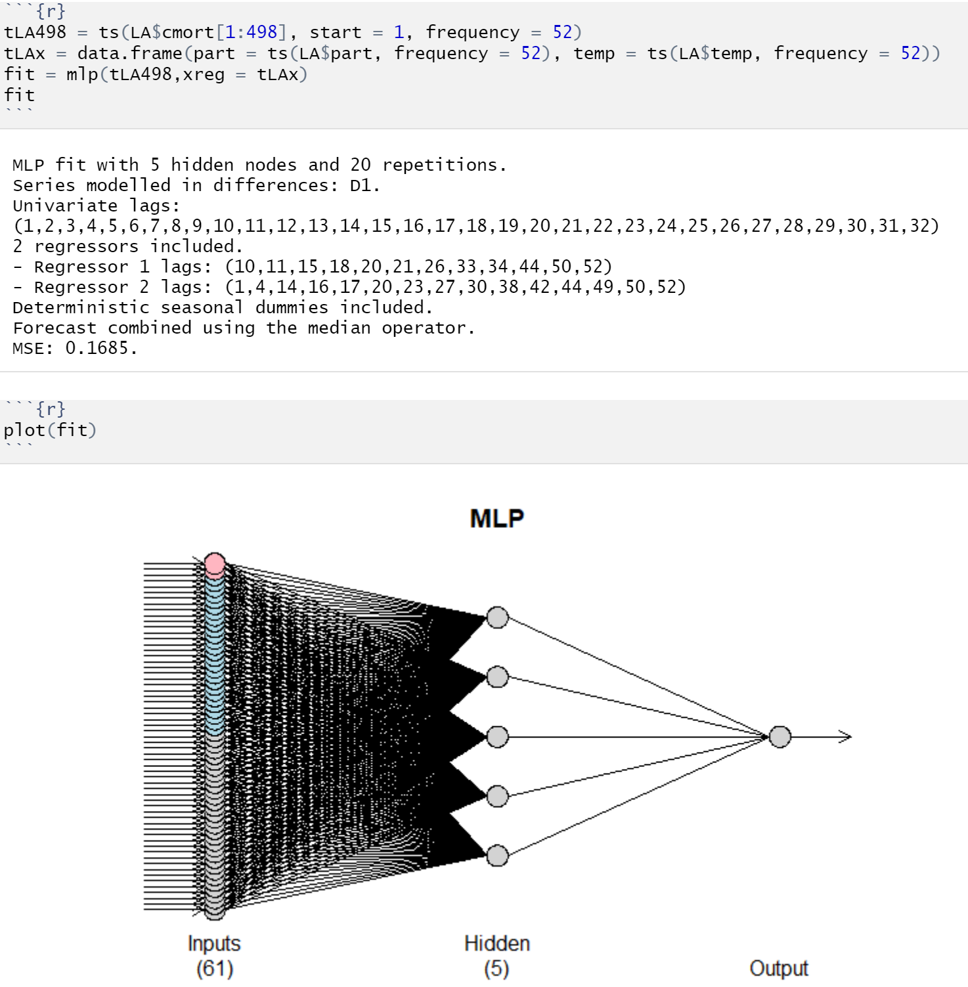
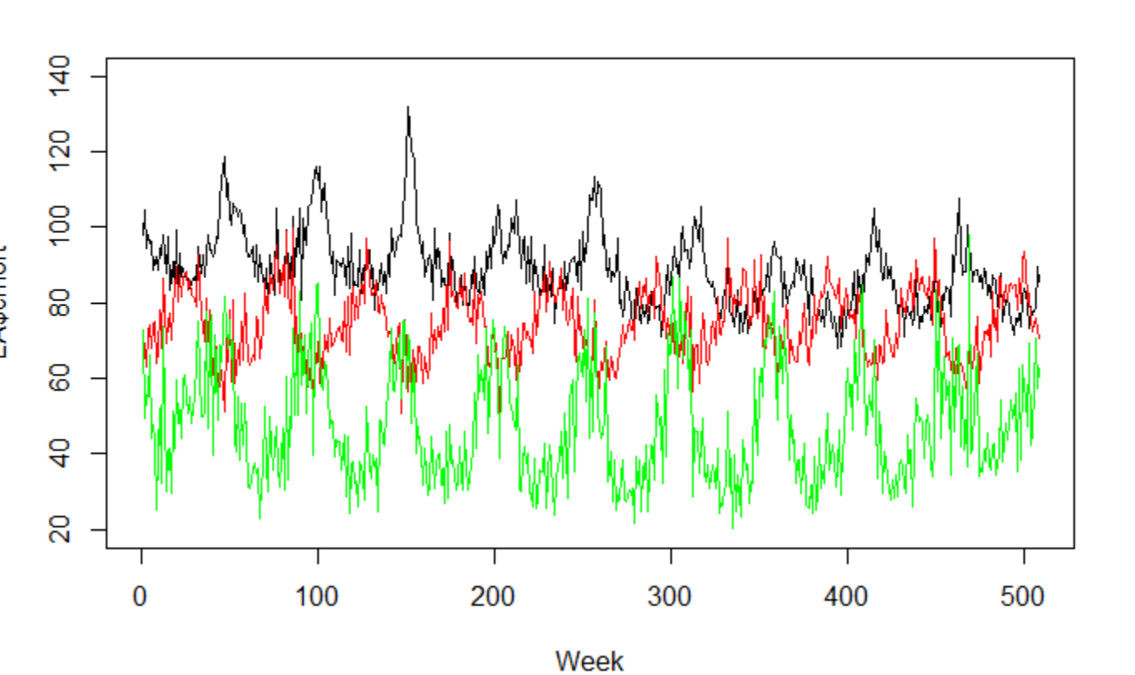
LA Pollution & Mortality - MLP

Slide 9
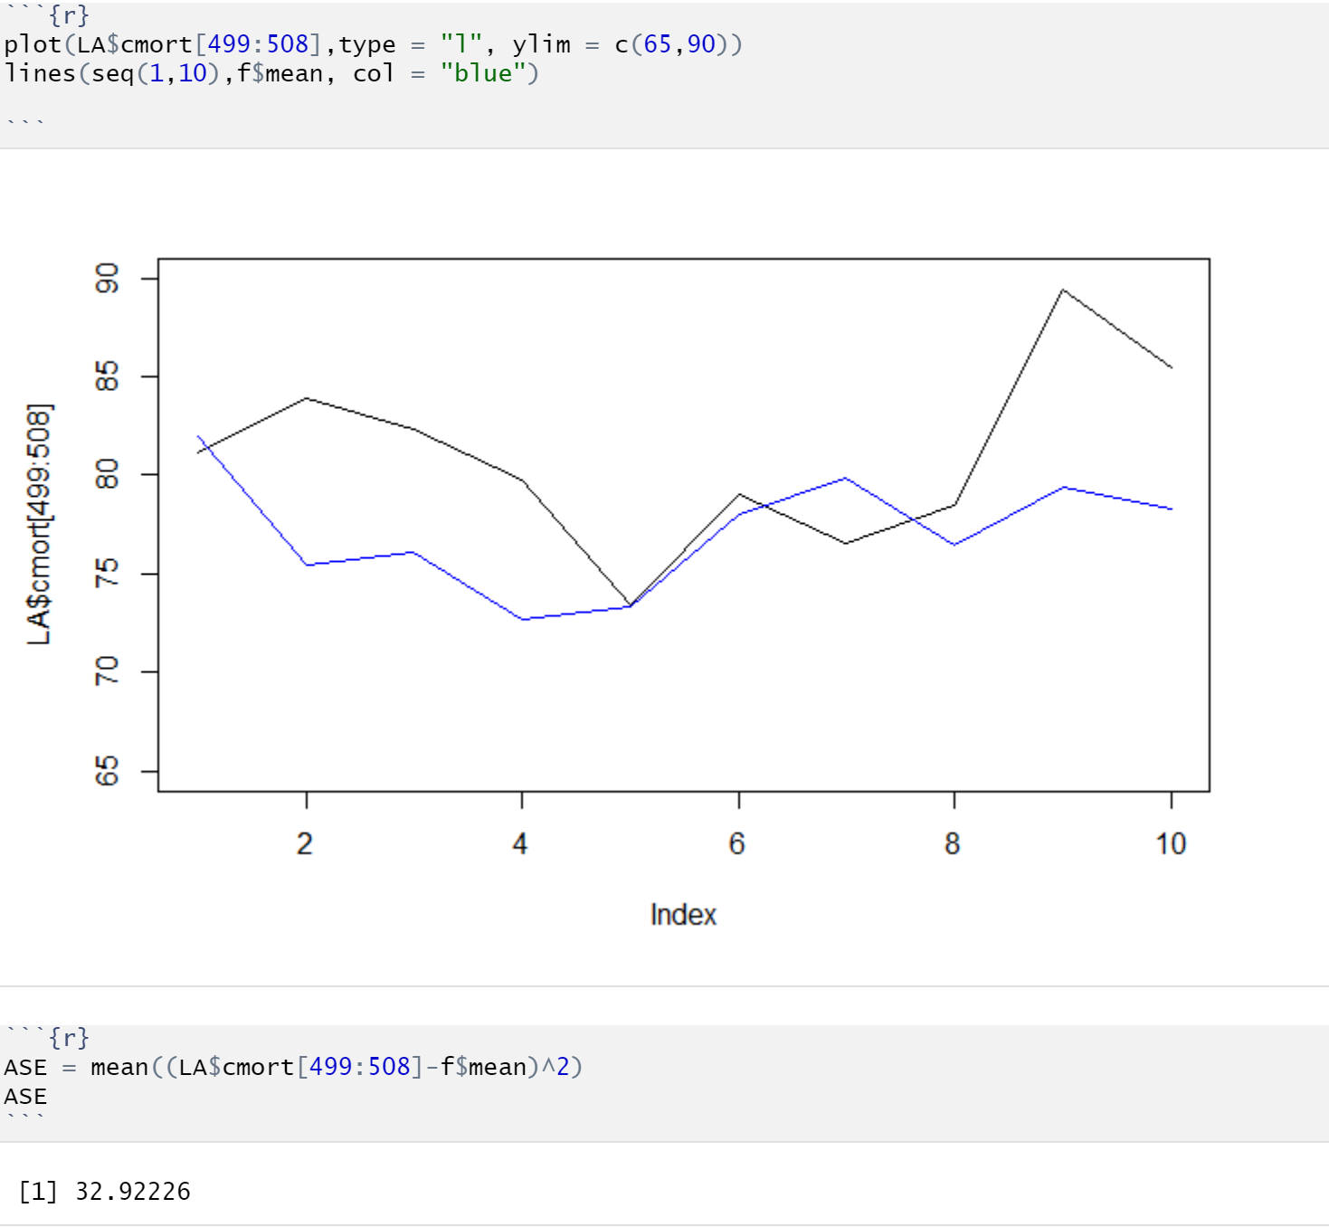
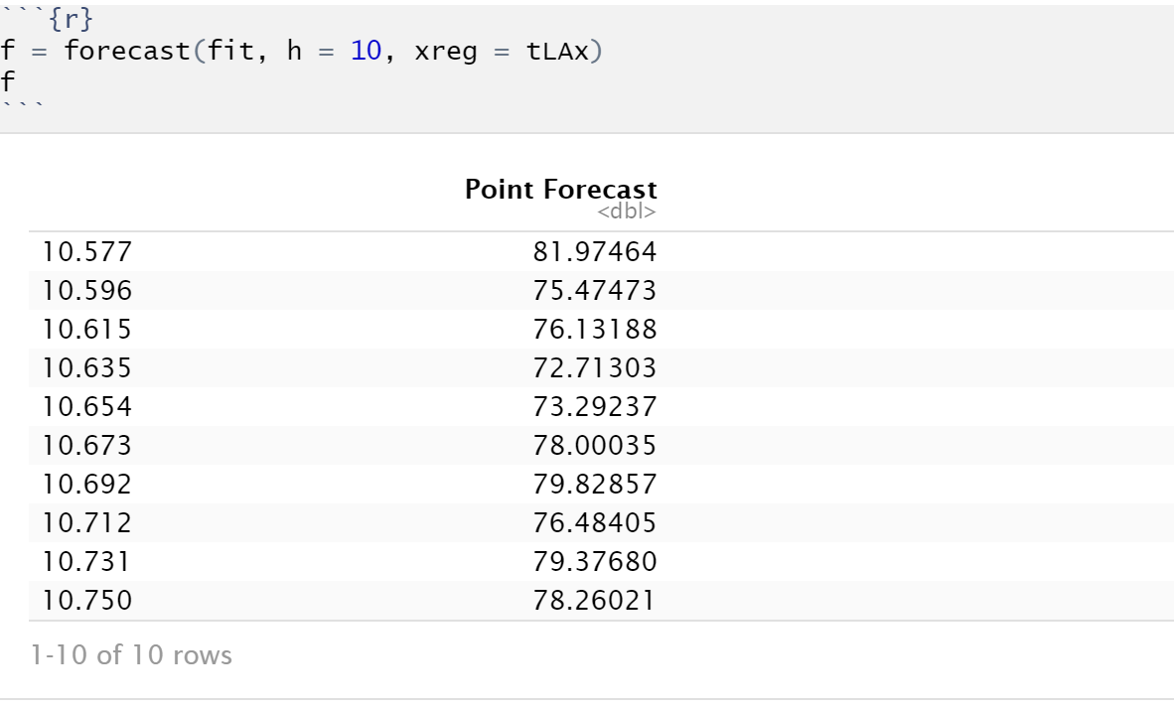
LA Pollution & Mortality - MLP

Slide 10
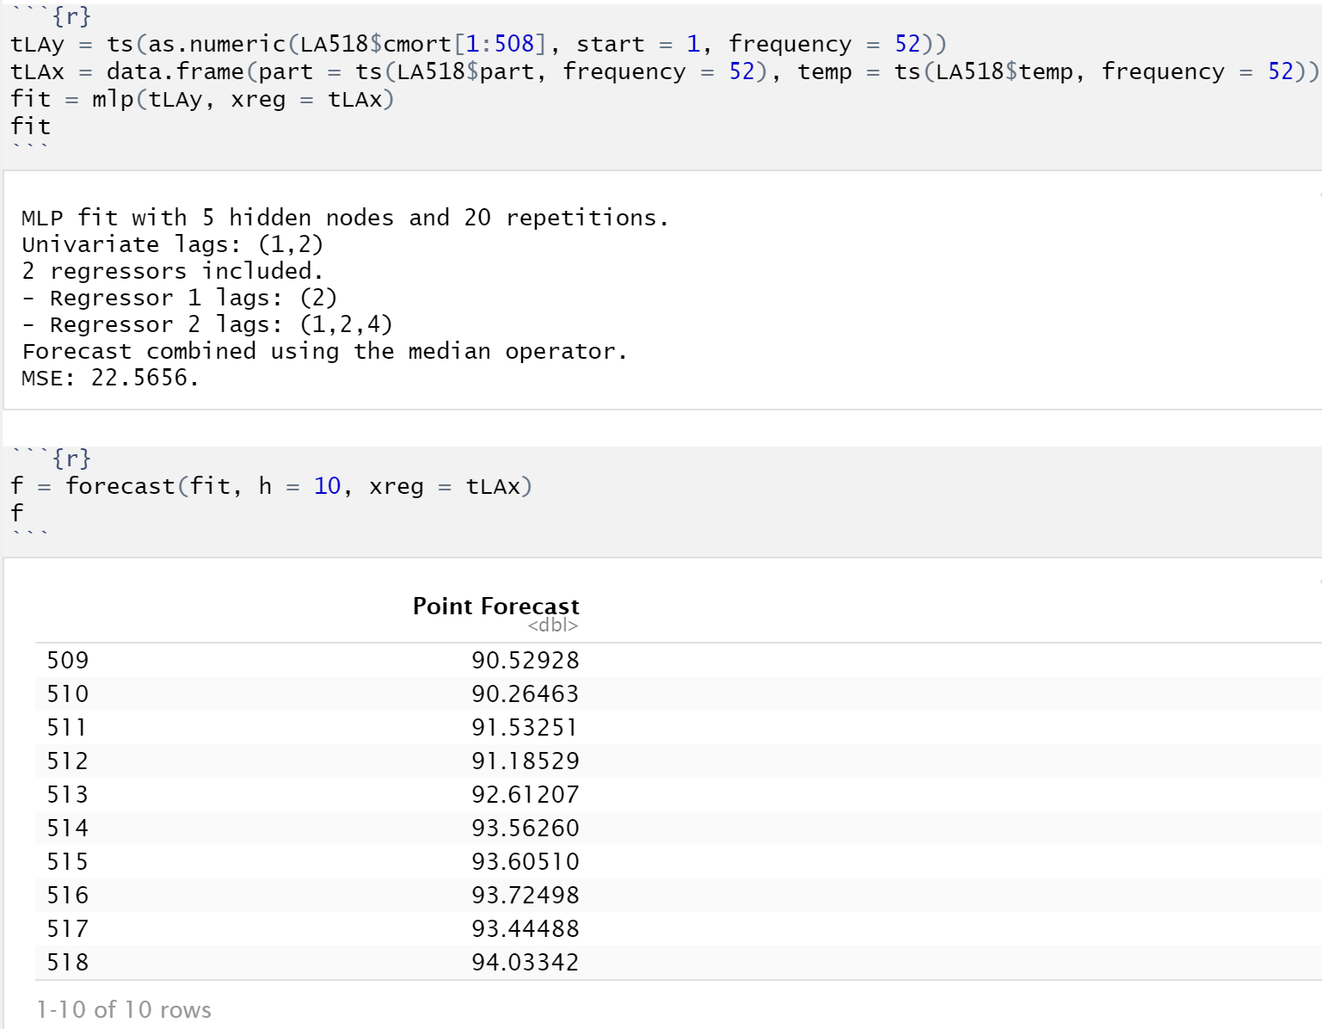
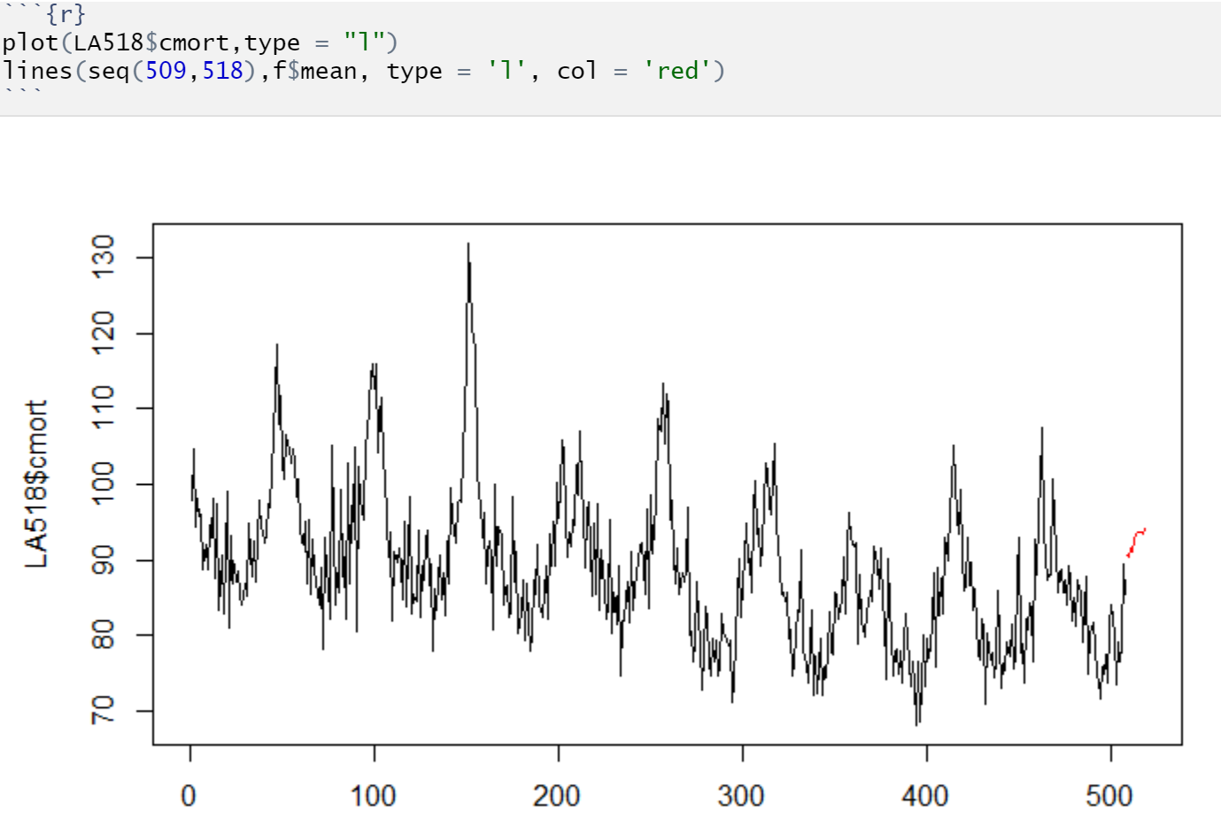
LA Pollution & Mortality - MLP

Slide 11
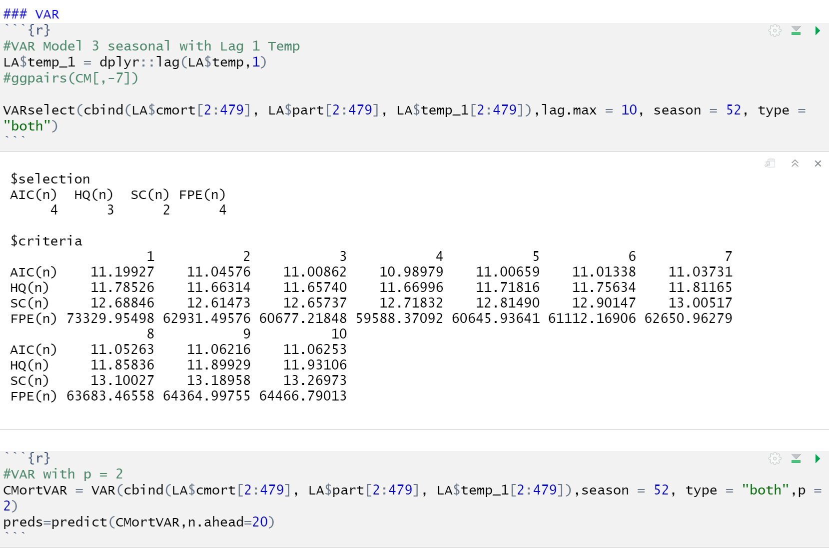
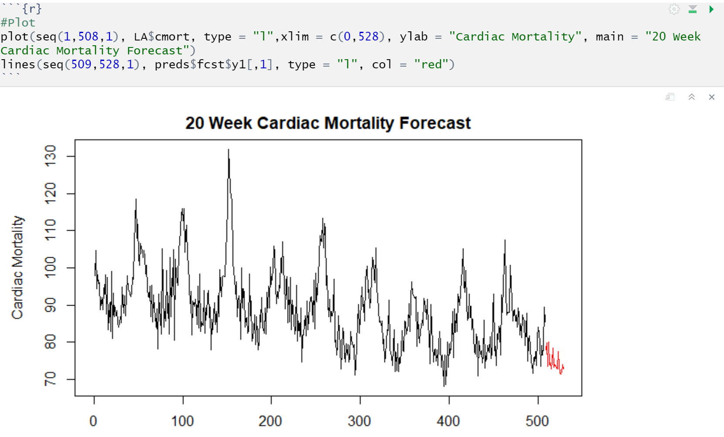
LA Pollution & Mortality - VAR

Slide 12
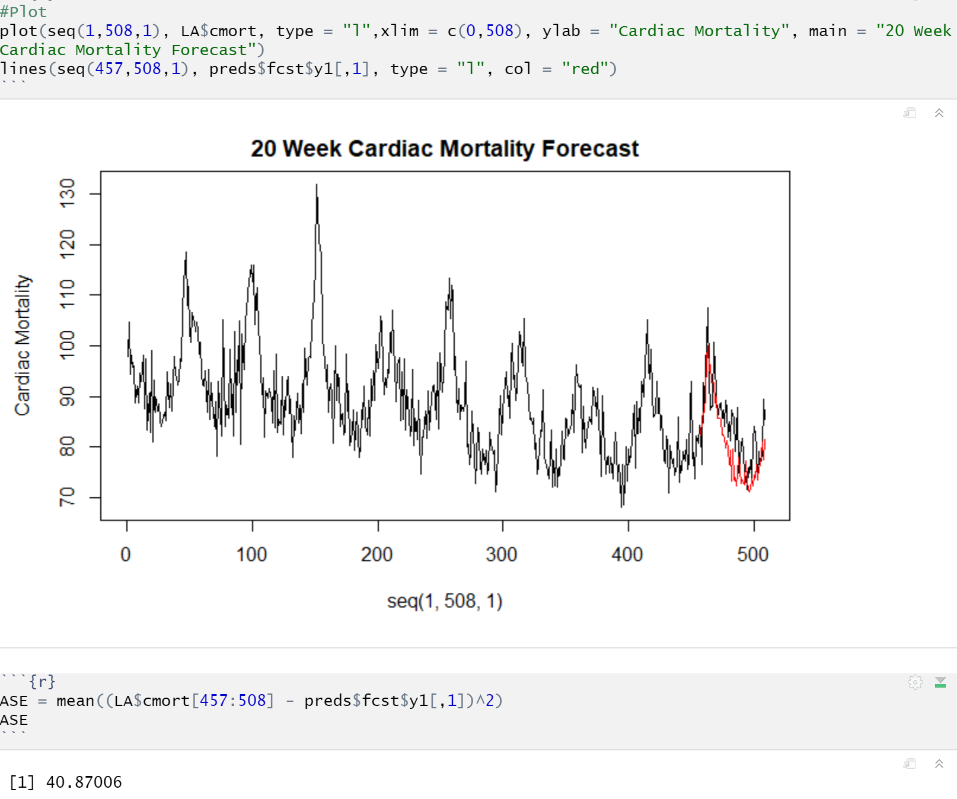
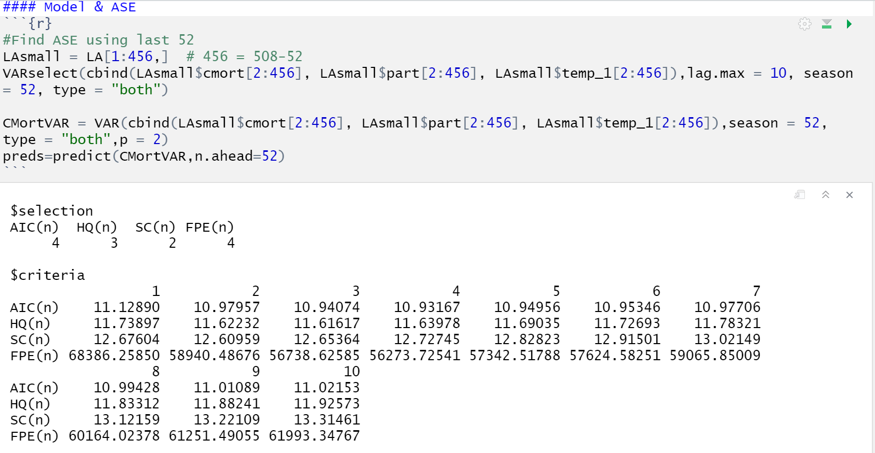
LA Pollution & Mortality - VAR

Slide 13
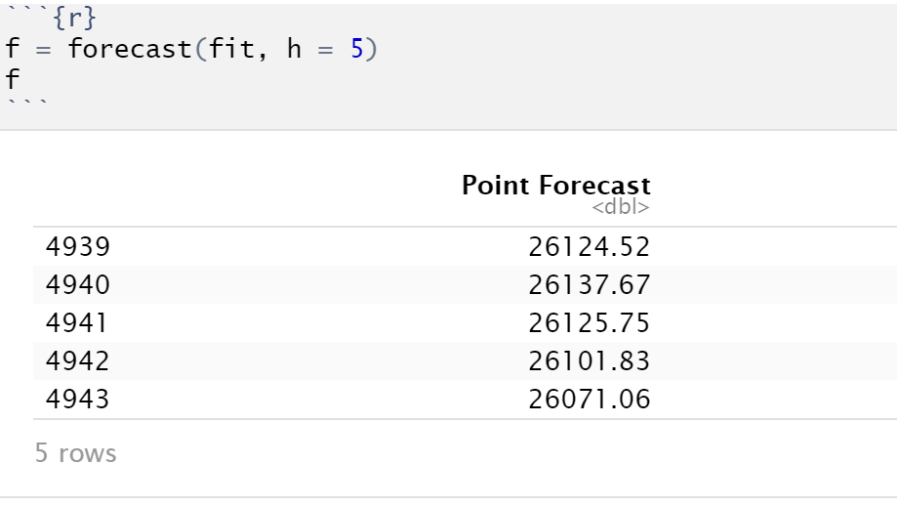
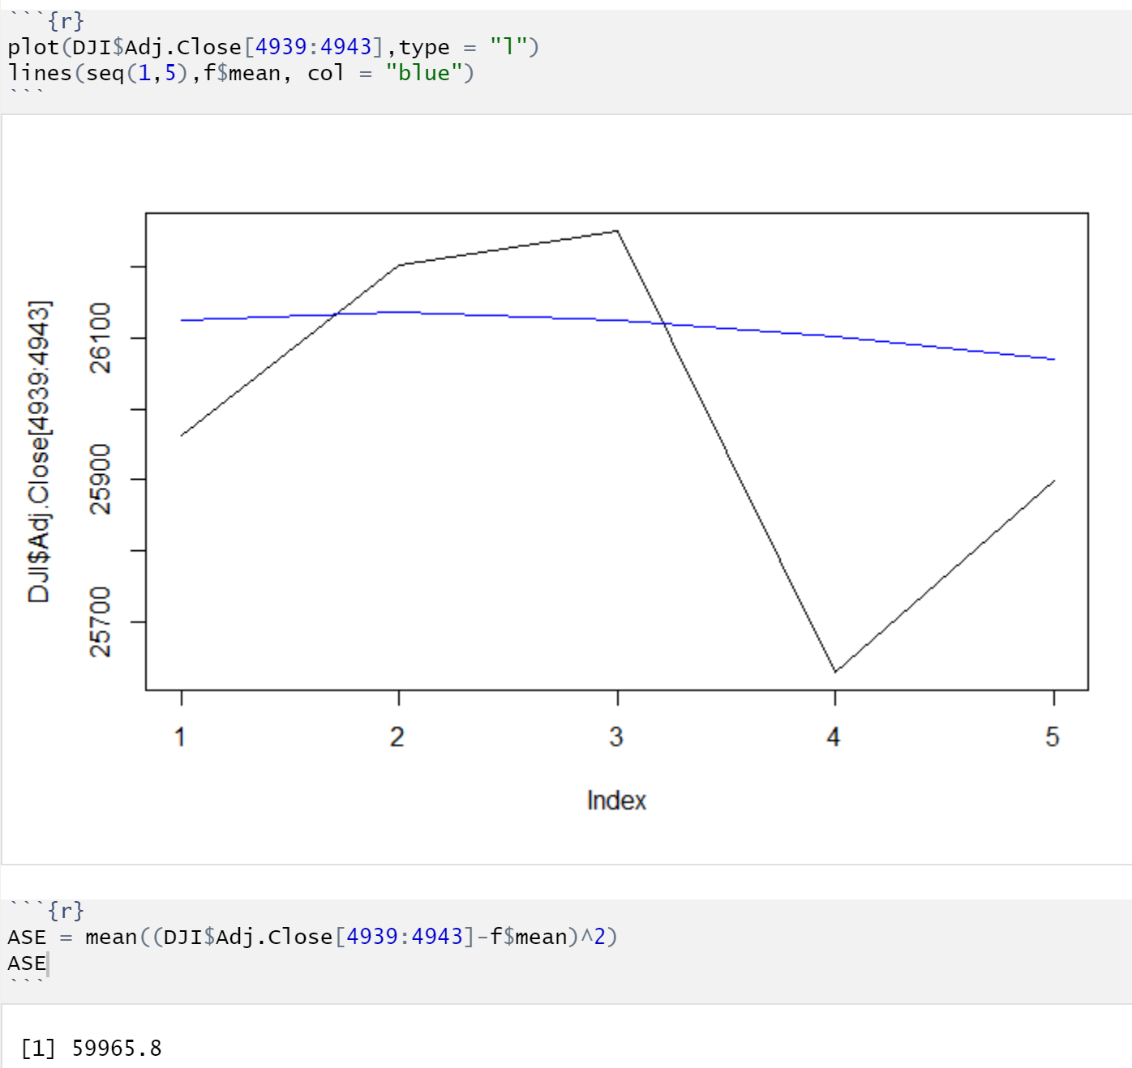
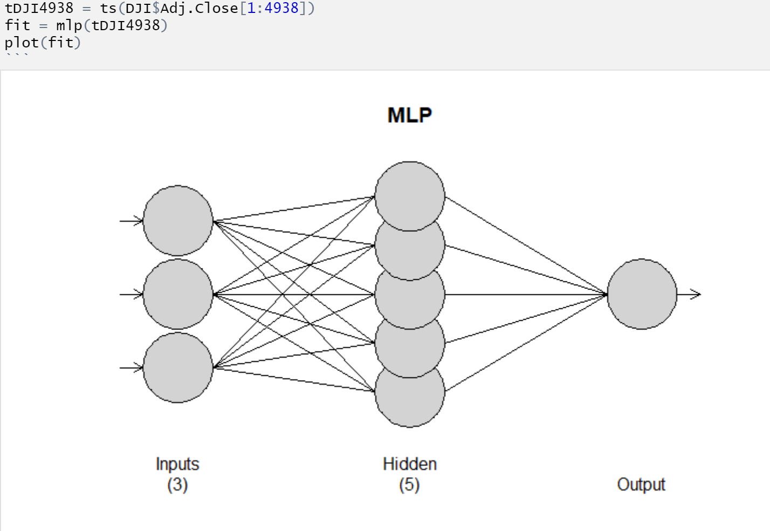
Dow Jones - MLP

Slide 14
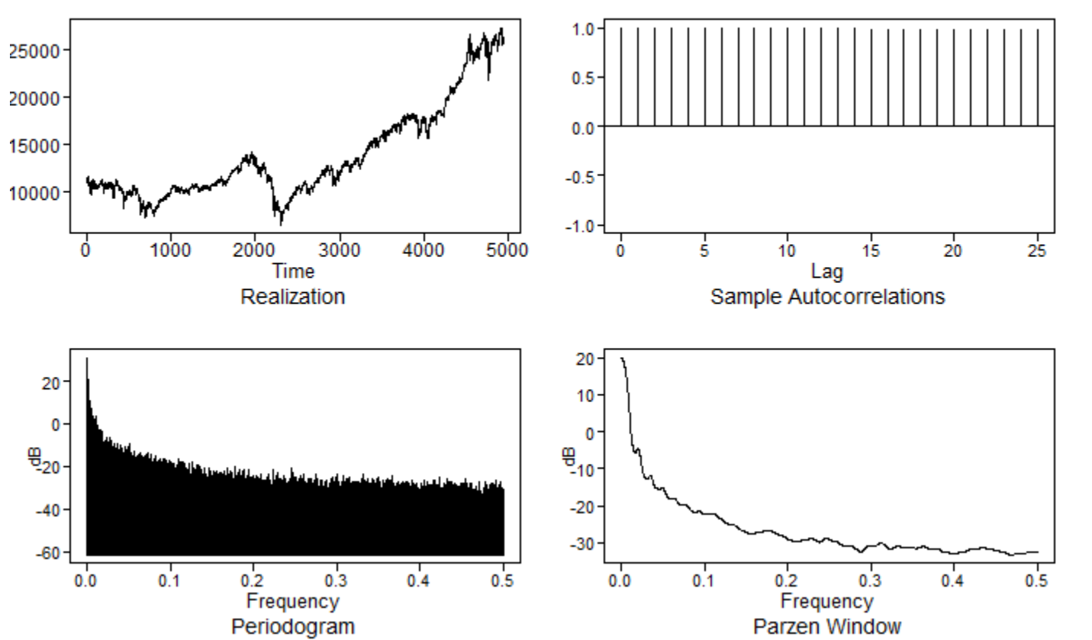
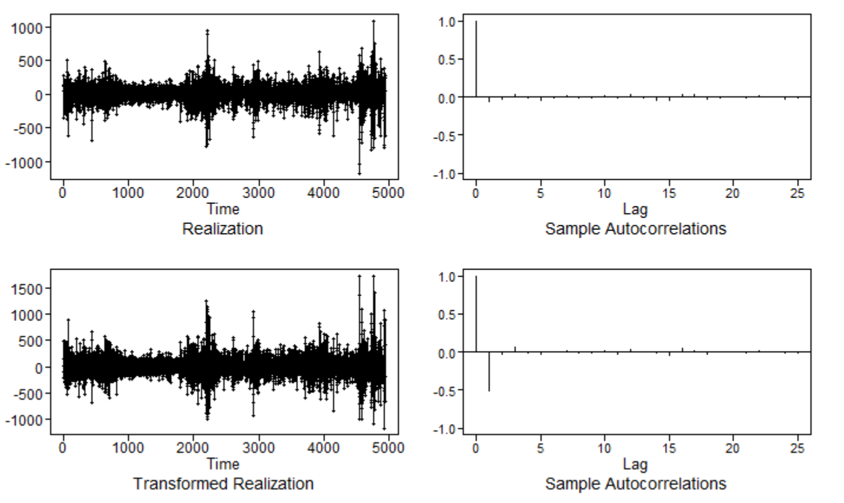
Dow Jones - ARIMA

Slide 15
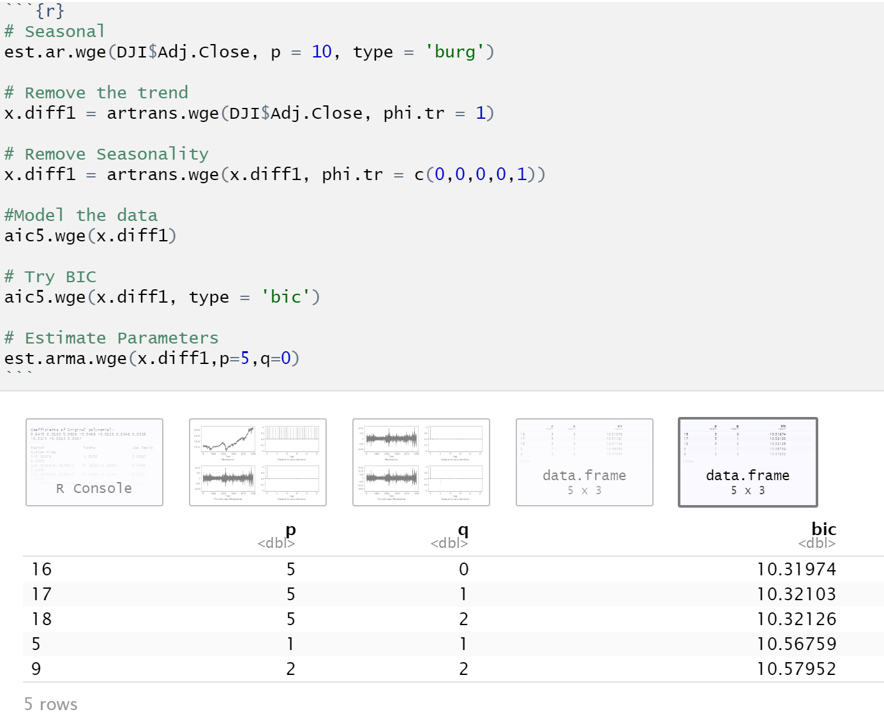
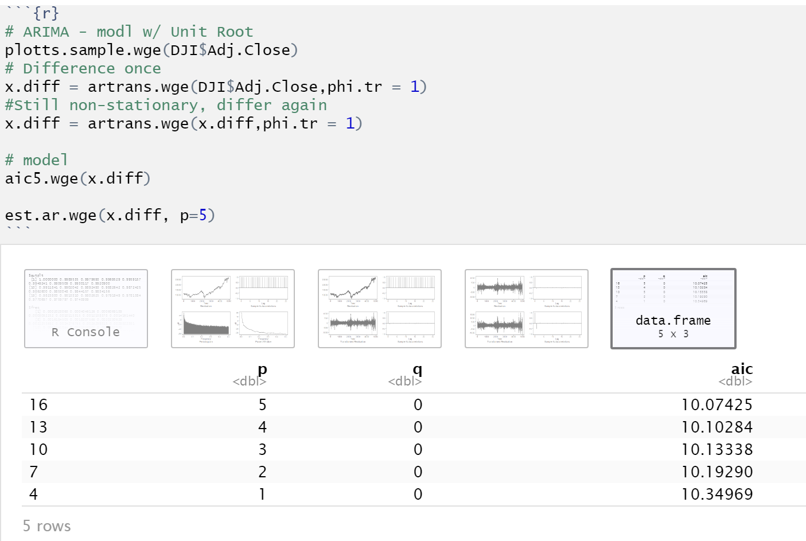
Dow Jones - ARIMA

Slide 16
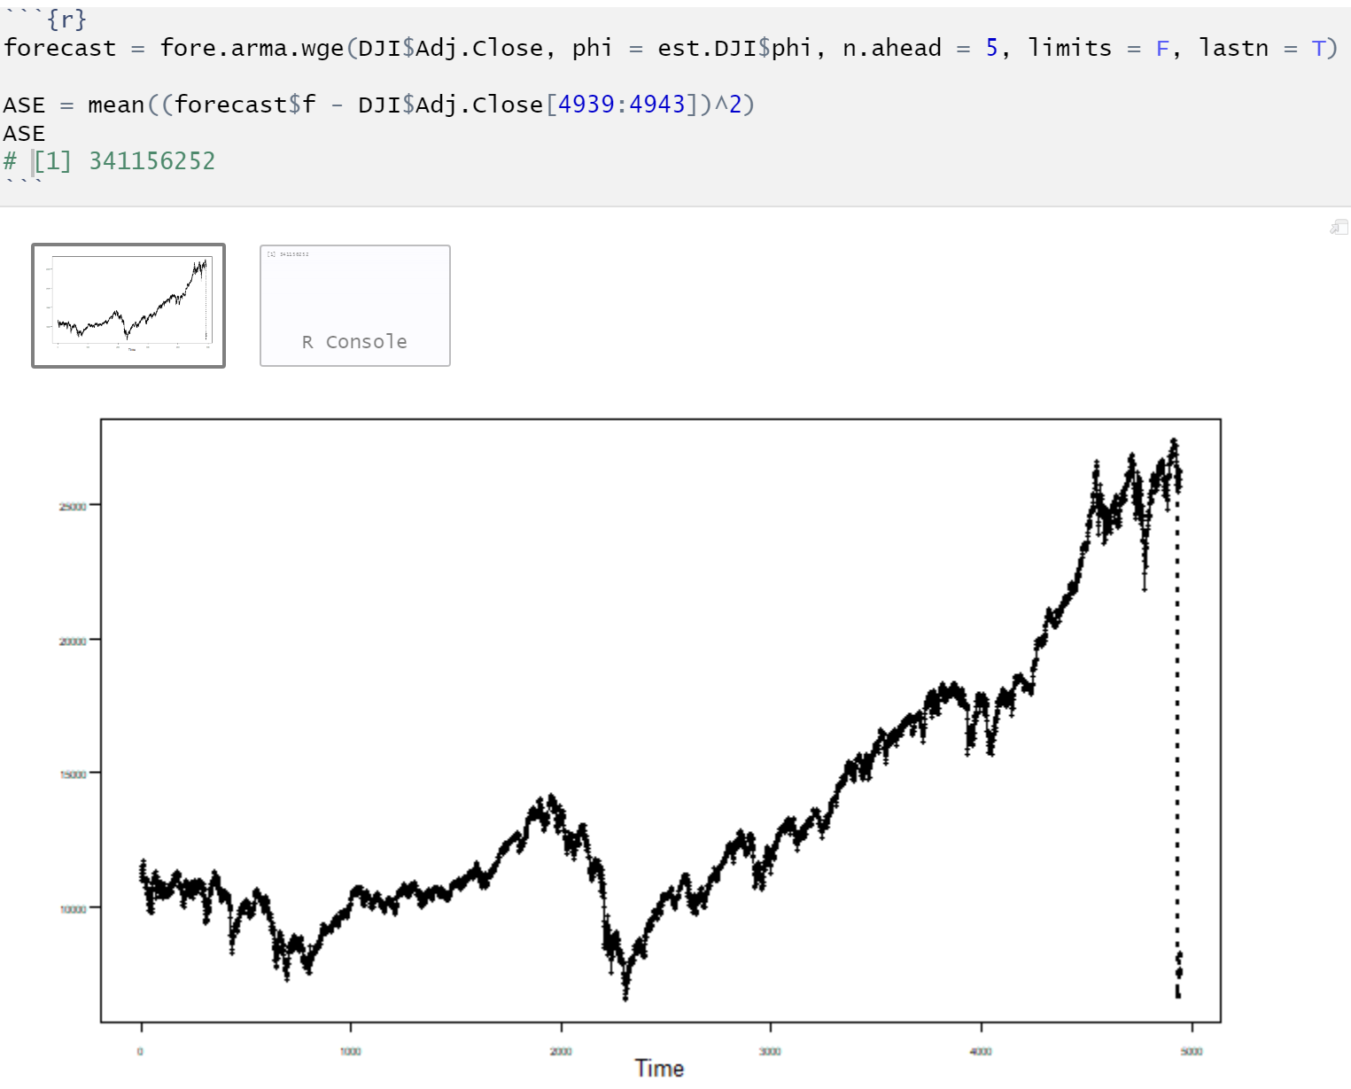
Dow Jones - ARIMA
Looking at the plot, I am not so sure where I went wrong.

Slide 17
MLP v. VAR/ARIMA
Oddly enough, in all the models the VAR performed better than the MLP models. While in some cases it was only by a small number, in others it was by a lot. In addition, it appears I made an error in the analysis of my own time series since the model is predicting a major crash. I am not certain where I went wrong in my forecast. I believed I removed the trend and seasonality.

